Slide 1
Welcome to middle school Comprehensive Science! I am so excited to be your science teacher this year. In our class, we’ll dive into exciting topics related to physical Science, Earth and Space, Life Science, and Scientific Inquiry. Get ready to explore, experiment, and discover the amazing world of science together. It’s going to be a fantastic year!

Slide 2
My Favorites:
Peonies, sunflowers and orchids
Color: Mauve , neutral colors and blue
Iced coffee and water
Fitness
Family time
Traveling
Science, Reading and history
Spicy foods
Teaching

Slide 3
Steps to enter
1. Walk in quietly and place your phones in your assigned number pocket.
2. Take out your class supplies and place your bookbag under your table.
3. Begin your bellringer and wait for me to give instructions.

Slide 4
All our study materials, including PowerPoints, weekly topics, and homework assignments, will be posted in Google Classroom. Make sure to check it regularly, paying close attention to the topics and due dates to stay on track and not fall behind.

Slide 5
Bathroom Rules: - You’ll receive a punch card for the year, which you must keep safe. If you lose it, you won't be able to go to the bathroom during my class.
- The card allows for 10-bathroom visits throughout the year. If you don’t use any of your punches, you’ll earn an extra credit "A" at the end of the quarter. (Keep them in a safe place)

Slide 6
Class Work Overview - Weekly assignments will be provided, with non-digital tasks completed in your interactive science notebooks (composition notebooks) and class plastic folders.
In-class labs, activities, and notes will also be stored in your plastic folders per each science domain.
A weekly playlist will guide you on what needs to be completed and what will be graded.
The playlist will also be available in Google Classroom for easy reference.
Keep all handouts and assignments organized, as they will be graded at the end of the week.

Slide 7
Homework Requirements
You will have weekly homework assignments that are due either daily or by the end of the week, depending on the weekly topics.
- A weekly homework checklist will be provided to help you stay organized; it will also be posted in Google Classroom.
- Each student is guaranteed one homework pass, which can be used to skip one homework assignment.

Slide 8
Please make sure to put away your personal items in the proper folders and keep your belongings organized. Don’t leave water bottles, class supplies, or any personal items in the classroom. Remember, other students and teachers will be sharing this space with us, so let’s keep it clean and tidy for everyone.

Slide 9
Asking for Classroom Help
First, check the daily agenda on the board or Promethean board for instructions.
If you’re still unsure, quietly ask the classmate next to you for clarification.
3. If you still need help, raise your hand while staying seated, and I will come to assist you as soon as possible.

Slide 10
Safe and Responsible Technology Use - **iPads:** Only use your assigned iPad—do not touch anyone else’s. Your iPad must be fully charged and ready for class. Not bringing a charged iPad will result in a lower grade, as it’s a mandatory classroom supply. - **Headphones:** Only wired headphones are allowed; no Air Pods. If you borrow headphones from me, you are responsible for taking care of them and ensuring they are not damaged. - **Cleanup:** At the end of class, make sure all technology items are properly stored and returned to their designated places.

Slide 11
When working independently in class, focus on your own work without talking to peers. Use the time wisely to complete your assignments. No copying—make sure your work is your own. Stay focused and do your best!

Slide 12
Cleaning Up After Yourself: Rules and Guidelines
Dispose of Trash Properly
All trash should be placed in the designated trash bin. Make sure to throw away any paper, wrappers, or other waste materials immediately.
Organize and Clean Your Workspace
At the end of the activity, make sure your workspace is free of clutter. Return all materials to their proper places and tidy up any spills or messes.
Designated Group Leader
Select a leader within your group who will be responsible for overseeing the cleanup process. This person ensures that everyone contributes to the cleanup and checks that the area is ready for the next activity or class period.
4. Complete Clean-Up Before Transitioning
Ensure that your group’s workspace is completely clean and organized before transitioning to the next activity or class. No mess should be left behind.
5. Check for Missing Items
Verify that no materials or personal belongings are left behind. Double-check that all items are accounted for and in their designated spots.
6. Final Inspection
The group leader should perform a final inspection of the workspace to confirm it meets cleanliness standards before dismissing the group.
By following these rules, everyone can contribute to maintaining a clean and organized environment, making transitions between activities smoother and more efficient.

Slide 13
Working effectively in groups, especially in science labs and classwork, involves a blend of communication, organization, and respect. Here are some key rules to follow:
1. Establish Clear Goals and Roles:
Define Objectives: Make sure everyone understands the goals of the project, experiment and or activity.
Assign Roles: Clearly define each person’s role and responsibilities to avoid confusion and overlap.
2. Communicate Effectively: Listen to each other’s ideas and concerns without interrupting. Be Clear and Concise Express your thoughts clearly to avoid misunderstandings.
3. Regular Updates: Keep everyone informed about progress and any changes in plans.
4. Be Respectful:
Value Contributions: Acknowledge and appreciate each member’s input and effort.
Maintain Respect: Avoid personal conflicts and focus on the task at hand.
Respect Differences: Be open to different perspectives and ways of working.
5. Collaborate and Support Each Other:
Share Workload: Distribute tasks evenly to ensure no one is overwhelmed.
Help Each Other: Offer assistance and feedback constructively.
Encourage Participation: Make sure everyone is involved and has a chance to contribute.

Slide 14
Working effectively in groups, especially in science labs and classwork, involves a blend of communication, organization, and respect. Here are some key rules to follow:
6. Manage Time Efficiently:
Plan Ahead: Develop a timeline for completing tasks and stick to it.
Prioritize Tasks: Focus on the most critical tasks first to ensure key objectives are met.
Monitor Progress: Regularly check on the progress of the group to stay on track.
7. Be Organized:
Keep Records: Document findings, decisions, and changes to keep everyone on the same page.
Use Tools: Utilize tools like shared documents or project management apps to coordinate efforts.
8.. Handle Conflicts Constructively:
Address Issues Promptly: Discuss any problems or disagreements as soon as they arise.
Seek Solutions: Work together to find solutions rather than assigning blame.
Learn from Experience: Apply lessons learned to future group work for better results.
By following these guidelines, groups can work together more harmoniously and effectively, leading to successful outcomes in both science labs and classwork

Slide 15
Science Lab and Class Work
When working with a partner, focus on being respectful, productive, and collaborative.
Respectful: Listen to others' ideas, share your thoughts politely, and value each person's contributions. Always communicate with kindness and consideration.
Productive: Stay focused on the task at hand, manage your time efficiently, and ensure that your work contributes to the group's goals. Complete assignments with care and accuracy.
Teamwork: Cooperate with your partners by dividing tasks fairly, supporting each other, and working together to solve problems. Encourage each other and build on each other’s strengths.
By adhering to these principles, you contribute to a positive and effective learning environment.

Slide 16
When interacting with a substitute teacher, here’s a short summary of expected behavior:
Be Respectful: Treat the substitute teacher with the same respect you would show your me.
Follow Instructions: Adhere to the directions provided by the substitute, and complete all assignments as instructed.
Stay Focused: Engage in your work and maintain a positive attitude throughout the class.
Avoid Disruptions: Refrain from talking out of turn, being disruptive, or engaging in inappropriate behavior.
Be Helpful: Assist the substitute if they need help understanding class routines or procedures.
Remember, your behavior will be noted, and any negative reports could result in detention when your regular teacher returns.

Slide 17
science class Work Folder
Organization: Keep your work folder organized and up-to-date. It should contain all your class assignments and materials provided. I will be doing random folder checks for a grade.
Take Home: Take your work folder home after each class to review and complete any additional work as needed.
Interactive Science Notebooks: These stay in class and should be used for interactive activities and notes that we do together in class. Most of our vocabulary practice and concept maps will be done here .
Responsibility: You are responsible for the condition and organization of your own work folder. Make sure it’s kept neat and accessible.
This system helps keep your work organized and ensures that interactive activities are easily managed in class.

Slide 18
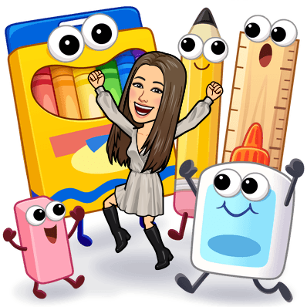
In science we will be using specific supplies. You have been given a list of specific supplies that needs to be brought to class every time we see each other. You will get a Z after 1 day of missing class supplies. Its very important that you come to class prepared.

Slide 19
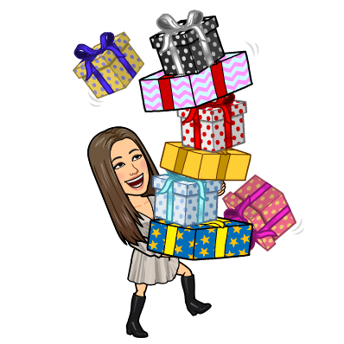
Rewards are given in class for participation and academic achievement.

Slide 20
Being in class on time and present is crucial because we cover a significant amount of material each session. Missing even a single class can lead to gaps in your understanding and make it challenging to keep up with the content. Consistent attendance ensures you stay engaged and are fully prepared for each topic, helping you succeed in your studies.

Slide 21
Cell phones are strictly prohibited in class. Upon entering, you must place your phone in your assigned pocket. The only exception to this rule is if I explicitly allow phone use for instructional purposes. Phones are not permitted in the bathroom if you leave the classroom.

